Slide 1



UDITA HEALTHTECH PRIVATE LIMITED
"Revolutionizing Healthcare Access and Wellness"
Let's
Collaborate!
+91 9924448900
meghmahesh@gmail.com
Ahmedabad- 380058, Gujarat

Slide 2



Introduction , Vision & Mission
At UDITA HEALTHTECH PRIVATE LIMITED, we create intelligent technology solutions for health, finance, and climate sustainability. We design and manufacture AI-powered systems, integrating advanced technologies like AI and IoT into everyday applications. We market, distribute, and resell innovative tech that drives real-world impact. Our solutions enhance healthcare access, financial inclusion, and environmental resilience. Udita Healthtech is revolutionizing healthcare financing with seamless reimbursements and 0% interest medical loans. We ensure stress-free, digital healthcare experiences for individuals and corporates alike.
VISION
MISSION
To lead innovation at the intersection of health, finance, and sustainability through advanced technology.”
“To create impactful, AI-driven solutions that improve lives, enable financial inclusion, and support a healthier planet.”

Slide 3






Challenges
Expensive and Fragmented Healthcare
Access to quality healthcare in India is often limited by high costs and a disjointed system. Preventive care is not widely available or affordable, especially in Tier 2 and rural areas.
Low Preventive Healthcare Awareness
Many individuals lack awareness of preventive care practices. Instead of routine check-ups, people tend to seek medical help only after symptoms worsen, leading to late diagnosis and higher treatment costs.
High Out-of-Pocket Expenses
Over 60% of healthcare spending in India is out-of-pocket. Patients often face unexpected medical bills without timely financial support, leading to delayed care or financial hardship.
"Bridging the Gaps in Health, Finance, and Climate Resilience through Technology."

Slide 4



Solutions for Market Challenges
Integrated Health & Wellness Platform :
A single platform offering preventive care, telemedicine, diagnostics, and easy financing for a seamless healthcare experience.
AI-Powered Health Plans :
Personalized recommendations for diet, fitness, and disease management using artificial intelligence for better health outcomes.
Flexible Health Financing :
OPD subscriptions, instant credit, and EMI options to make medical expenses affordable and stress-free.
"Smart Solutions for a Healthier, Safer, and More Sustainable Tomorrow."

Slide 5
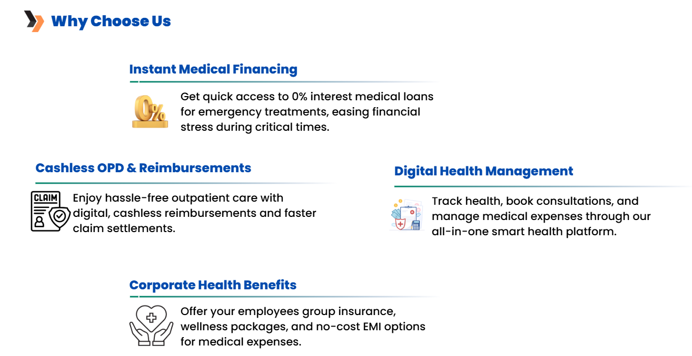

Slide 6




our offerings
"Innovative tech for health, finance, and sustainability.
Delivering smart solutions from design to distribution."
Healthcare Financing Solutions
Advance insurance reimbursement and 0% interest medical loans with flexible EMIs for stress-free treatments.
Employee Healthcare Benefits
Group insurance, wellness programs, OPD access, and mental health support with instant healthcare credit lines.
Preventive Care & Discounts
Routine check-ups, diet consultations, and pharmacy/diagnostic discounts at leading hospitals and clinics.
Digital Health Management
A smart platform for health tracking, booking consultations, and seamless insurance claim assistance.

Slide 7
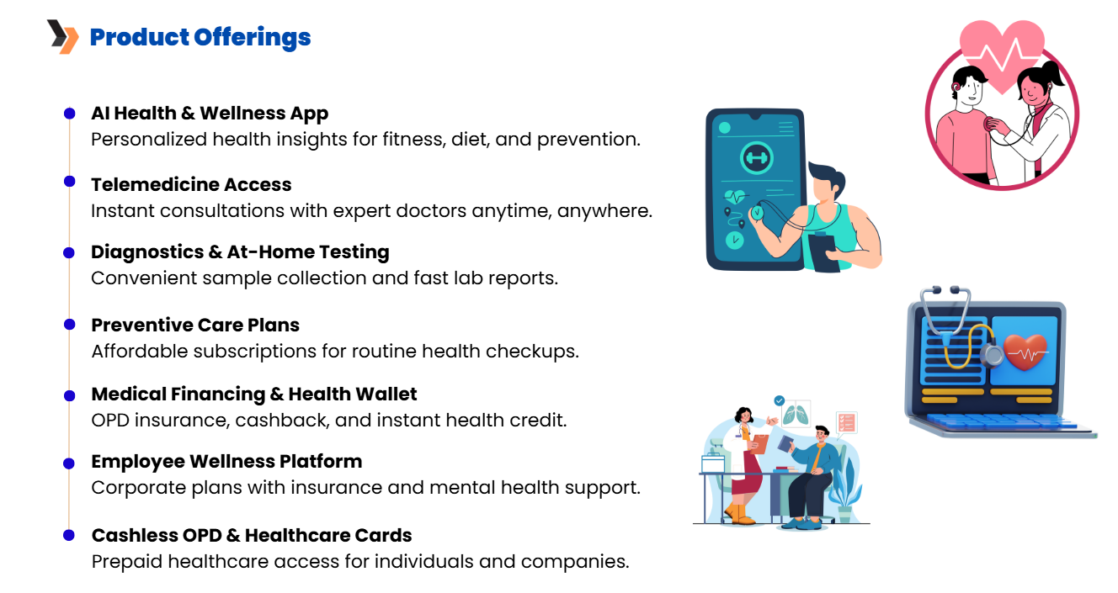

Slide 8




Our Unique Strengths & Advantages
Integrated Multi-Sector Expertise
AI & Advanced Tech Integration
We operate across healthtech, fintech, and climate tech, creating holistic solutions.
We leverage artificial intelligence and data-driven systems for smarter outcomes.
End-to-End Capabilities
Commitment to Social Impact
From product design to distribution, we manage the full innovation lifecycle.
Our solutions focus on accessibility, inclusivity, and sustainability for long-term value.

Slide 9
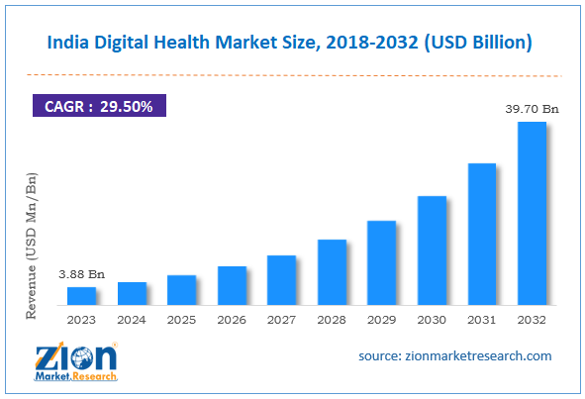

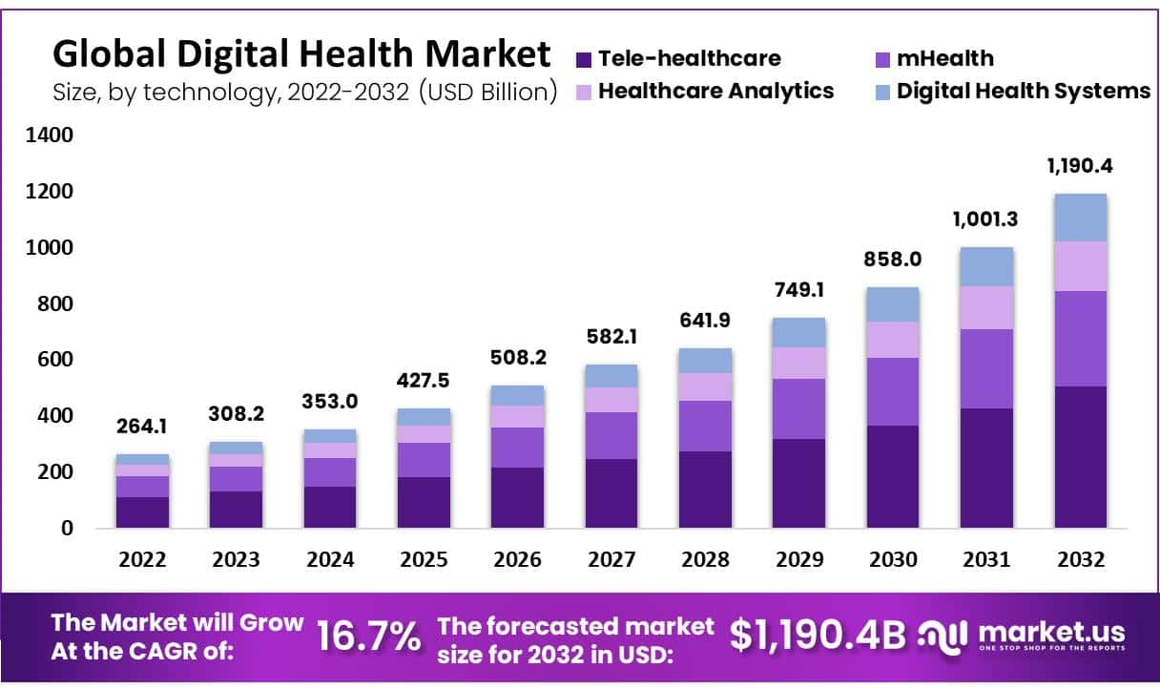
Market Opportunity and Growth Potential
Indian Digital Health Market – India’s digital health market is projected to grow to $37 billion by 2030, driven by increasing demand for telemedicine, digital wellness, and health financing solutions. This growth is fueled by smartphone penetration, government initiatives, and rising health awareness.
🔗 Source – Invest India
Out-of-Pocket Expenditure in India – Nearly 80% of healthcare expenses in India are paid directly by patients, indicating a massive need for medical financing and insurance-backed digital solutions.
🔗 Source – NITI Aayog Report on Health System for a New India.
Global Digital Health Market – Globally, the digital health market is expected to reach $660 billion by 2030, growing at a CAGR of 18.6% from 2022, driven by telemedicine, AI integration, and consumer-centric health tech innovations.
🔗 Source – Precedence Research
Market Drivers
Rising Demand for Digital Solutions :
Increased adoption of AI, telemedicine, fintech, and sustainable technologies across sectors.
Government & Regulatory Push :
Strong policy support for digital health, fintech inclusion, and climate resilience initiatives.

Slide 10
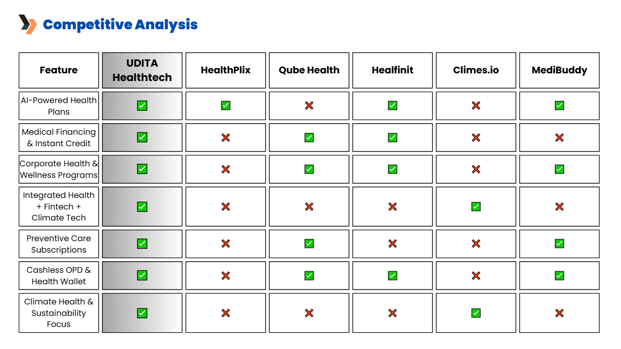

Slide 11

Our Revenue Generation Strategy
Subscription & Service Revenue
Earnings from monthly/annual health plans, telemedicine, and diagnostics.
Fintech & Insurance Partnerships
Income through collaborations with lending partners and insurance providers.
Corporate Wellness & Wallet Usage
Revenue from B2B health programs, wallet transactions, and medical loan processing fees.
"Driving Growth Through Innovation, Integration, and Impact."

Slide 12

Market Segmentation, Targeting & Positioning
Segmentation :
Industry : Healthcare, Financial Services, Environmental Agencies
Customer Type : Hospitals, Fintech startups, Government bodies, NGOs, Corporates
Technology Readiness : Tech-savvy, digital-first organizations
Targeting :
Hospitals & Clinics seeking AI-enabled diagnostics and remote care tools
Banks & Fintech Firms needing secure, scalable digital platforms
Government & CSR Programs focused on climate health and sustainability
Positioning :
"India’s only integrated AI-powered platform solving challenges at the intersection of health, finance, and sustainability with end-to-end smart solutions."
This positions us as a multi-sector innovator, distinct from single-domain competitors, offering high-impact, scalable technology.

Slide 13




Strategic Go-To-Market Plan
Corporate (B2B) Partnerships
We aim to partner with companies to provide employee wellness programs, including health insurance, OPD benefits, and preventive care, enhancing workforce well-being and retention.
B2C Digital Engagement
We will use targeted digital marketing, influencer collaborations, and referral programs to attract individual users seeking accessible and affordable healthcare services.
Fintech & Affiliate Expansion
We will work with NBFCs and banks to offer 0% EMI healthcare financing and build a strong affiliate and referral network to boost OPD subscriptions and platform adoption.
Strategic Healthcare & Insurance Tie-Ups
By collaborating with hospitals, clinics, and insurance providers, we ensure integrated service delivery, cashless OPD access, and faster claims processing.

Slide 14
Aim To Scale Up for next 5 year
Year 3-4 : Expand into Global Markets
Enter select international markets, focusing on regions with similar needs in health, fintech, and climate sustainability, particularly in Southeast Asia and the Middle East.
Phase 1 (Year 1-2)
Phase 3 (Year 5)
Year 1-2 : Establish National Presence
Focus on expanding our footprint across key Indian states, targeting Tier 1 and Tier 2 cities, and refining our offerings based on customer feedback.
Phase 2 (Year 3-4)
Year 5 : Become an Industry Leader
Position UDITA as a leading provider of integrated AI-powered solutions, with a diversified product portfolio and a strong market share in multiple sectors.

Slide 15
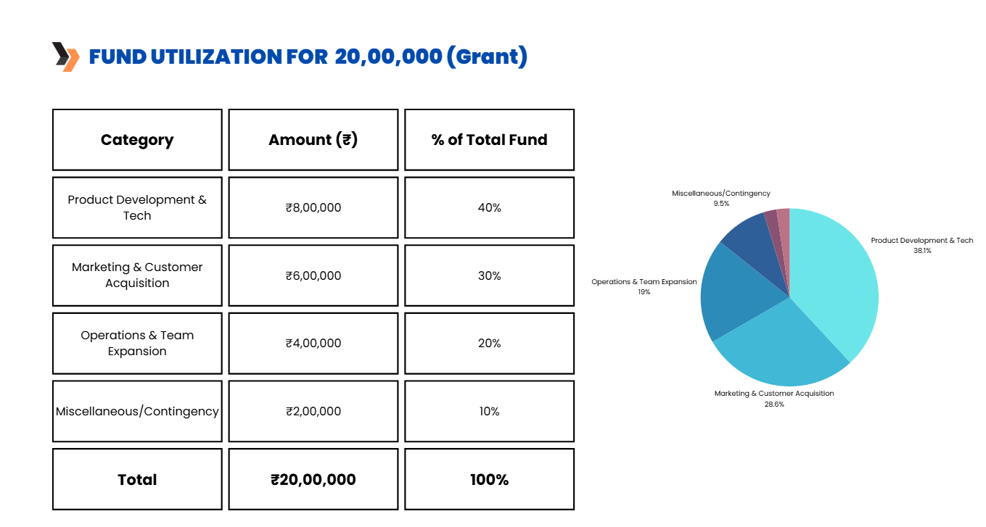

Slide 16



Leadership
Dr. Mahesh Makvana
Meghana Makvana
(Founder and Managing Director)
(Co-Founder)
Dr. Mahesh Makvana
Founder and Managing Director of Udita Healthtech Pvt Ltd. Holds qualifications in MBBS, AFIH, DNB(f), DPHM, with expertise in ESG, finance, and healthcare strategy. He leads with a vision to merge healthcare, fintech, and sustainability through innovation.
Meghana Makvana
Co-Founder and Commerce Graduate specializing in finance and strategic planning. She oversees accounting and financial operations. Plays a key role in shaping the company’s growth strategy.

Slide 17




Get In Touch
•Join us in transforming healthcare with fintech solutions!🚀
+91 9924448900
meghmahesh@gmail.com
04 AAKASHGANGA BUNGLOW, OPPOSITE SHIVALIKA SOC., Ghuma, Daskroi, Ahmedabad- 380058, Gujarat

